Slide 1
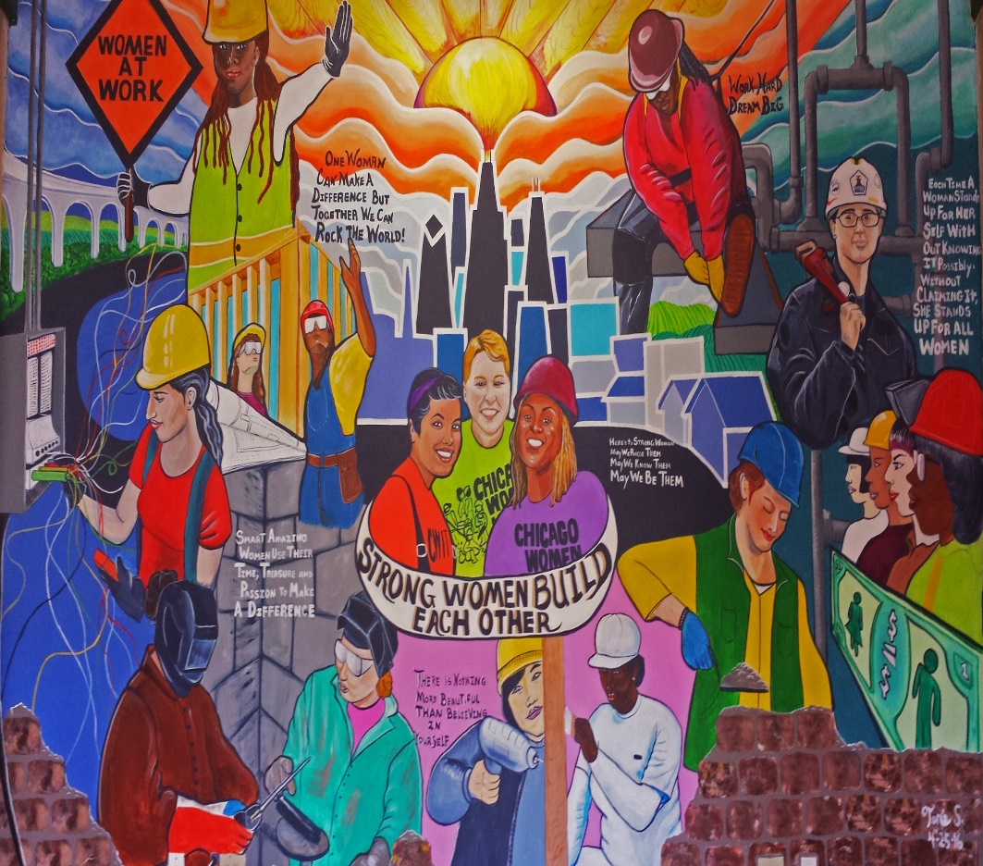
SupportING Women's Success In Construction Apprenticeships, JOB SITES AND UNION
Mentoring and Allyship

Slide 2
WHY MENTORSHIP MATTERS TO WOMEN
BARRIERS TO WOMEN’S INCLUSION AND RETENTION
Disparate, unequal on-the job training,
More limited hiring, job types and overtime assignments
Deleterious impact of micro-inequities over time –molehills that become mountains!
Male-dominated culture can unintentionally be exclusionary

Slide 3
Mentorship: Tradition vs Inclusion
It’s happening everywhere! It’s probably happened to you! It’s also a matter of survival.
Teaches the unwritten rules for success.
Traditionally, mentoring has occurred as a natural process, coupled with apprenticeship, Predominantly and historically between men.
Happens less between men and women or between women professionally.
It is more common informally for women in family structure – Grandmother, mother, sister, aunt or cousin.

Slide 4
WOMEN OF UA LOCAL 130
BY SISTERS, FOR SISTERS, DESIGNED TO:
Build, sustain and maintain a safe community
Provide solidarity, support, compassion and mentorship
Give every sister multiple contacts to reach out to for technical questions, social guidance and support.
To teach by example many different ways and perspectives to reach success.
To actively encourage female apprentices to lead.
A GRASSROOTS & DO IT YOURSELF APPROACH
Notes:
It’s happening everywhere! It’s probably
happened to you! It’s also a matter of
survival.
Happens less between men and women or between women professionally.
It is more common informally for women in family structure – Grandmother,
mother, sister, aunt or cousin.

Slide 5
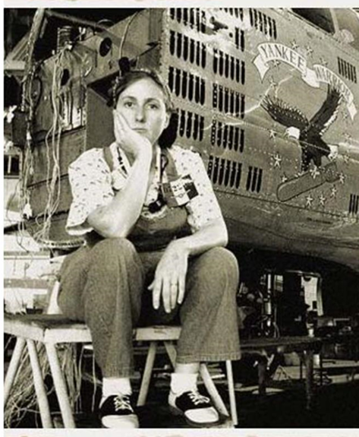
WOMEN OF UA LOCAL 130
Started from the bottom and assessed the problem
For years the women in the local were few and very isolated from each other
Retention was horrible
Leadership was not welcoming
Many extra barriers for women to even get in
Environment was pretty hostile
It felt pretty crappy recruiting new apprentices since they didn’t have much of a chance
A few of us that made it kept in loose
touch.
We decided to do something about it

Slide 6
WOMEN OF UA LOCAL 130 Getting Started
We started with 3 Journeywomen
We heard about upcoming change in our Union leadership and “doubled down”:
We kept networking with officers and members who were or might be allies (many based only on their experiences with us- LEVERAGE YOUR REPUTATION)
We showed up at EVERYTHING together (we already were, just now intentionally)
We started recruiting new sisters for the apprenticeship
WE WERE SEEN
Notes:
We heard about upcoming change in our Union leadership and “doubled down”:

Slide 7
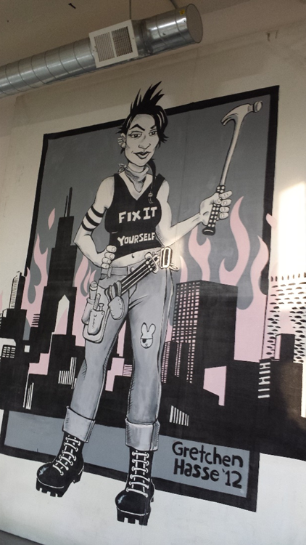
WOMEN OF UA LOCAL 130 Starting Out: Setting Goals
Our goals were simply:
improving retention
improving quality of female apprentices
Support and increase recruitment,
building a community, mentorship, support
We made a commitment to the new apprentices
We started knowing change takes a long time. Make it better for the next woman!
•

Slide 8
WOMEN OF UA LOCAL 130 Our Goals Were NOT:
To make a committee to hear the grievances of the women, or take those grievances to the union.
We didn’t elect leaders or agree on process.
Agreed to just keep checking in, be ﬂexible, and invite everyone. Don’t stress about this.
Let the “deciders” of direction be who shows up to do the work.
We decided to be informal. A separate but visible force, we answer only to ourselves.
No union involvement. Safe space. No one to report back to.
A GRASSROOTS & DO IT YOURSELF APPROACH

Slide 9
WOMEN OF UA LOCAL 130 We Agreed On A Few Principals:
We don't have to be friends (It’s cool if you don’t like me)
We invite all the sisters (chilly journeywomen/brand new apps)
Attraction vs. promotion (casual & cool)
Respectful, civil and confidential (no drama!)
We set a couple realistic goals:
Once monthly meet ups with everyone invited (hands on skills for apprentices)
Every apprentice gets a individual call once a month (“the big 3”) + 1

Slide 10
WOMEN OF UA LOCAL 130 What We Do: Mentoring Is A Core Component
Maintain a private Facebook group to check in, post union events, post pictures of piping victories or failures, ask questions
Share opportunities and maintain community
Monthly meet-ups
Hands on project that addresses questions that have come up
Notes:
It’s happening everywhere! It’s probably
happened to you! It’s also a matter of
survival.
Happens less between men and women or between women professionally.
It is more common informally for women in family structure – Grandmother,
mother, sister, aunt or cousin.

Slide 11
WOMEN OF UA LOCAL 130 Mentoring takes many forms
Individual calls monthly to each apprentice (sometimes more if there’s a situation going on).
Three basic questions:
How’s work?
How’s school?
Is everything cool with your car and your home situation?
Volunteer together (every other month average). Either for Chicago Women in Trades or the union.
Tutoring whenever sisters ask. We put together a study group or tutor session whenever asked.

Slide 12
WOMEN OF UA LOCAL 130 - TOOLS WE USE Sample tracking/ “hive mind” sheet:
Tracks:
Name/Phone #
Who called
Big 3
Seen?
Working?
What shop?
Notes
School Day
Family, kids?
Lives in:
Use “google sheets”
It’s a free app
Your sheets can only be viewed by your invited leaders
Use on a desktop or phone
Updates in real time.

Slide 13
WE ARE AN EMPOWERMENT MACHINE! Things we do together:
Tutor each other
Recruit at job fairs
Attend union meeting together: encouraging participation and visibility
Go to union political actions
Prepare applicants for apprentice test
Have barbecues
Teach classes at community organizations
MORE RECRUITING
Run races, play softball

Slide 14
WOMEN OF UA LOCAL 130 Strategies for Solidarity, Sisterhood, and Success
Maintain a “policy” of keeping the door open, meaning: we keep inviting every sister whether she shows up or not.
We remind our apprentices regularly that we often rise and fall together. This shared mentality helps with difficult personalities: keep it civil and friendly, no drama! This is bigger than us as individuals.
We try to keep showing by example instead of lecturing a misguided sister. In addition, not everyone is enthusiastic about participation.
90% of new apprentices are very active. Almost all are working and thriving.
Some sisters choose to keep to themselves and generally struggle.
Some Journeywomen are thrilled to help and finally have a community.

Slide 15
WOMEN OF UA LOCAL 130 We remind ourselves all the time:
You don’t need to have the answers. Just help ﬁgure it out! Ask the other “leaders” for guidance
These are adults! Think about how you talk and approach. Yes, you know more about your trade but watch your tone. Say: “in my experience in the union I’ve found that…” vs. “you’re an idiot! Why are you doing it so wrong?”
Show by example, all the time. You can be real friends after they Journey out. Don’t play favorites.
You can’t control the apprentices. Sometimes there are bad situations. Decide what kind of leader you want to be through the good and bad.
Highlight everything awesome your people are doing! Bring them up!

Slide 16
WOMEN OF UA LOCAL 130 Strategies for Solidarity, Sisterhood, and Success
Building mentors and leaders for the future.
Constantly bringing up new leaders/empowering:
Fourth year apprentices are part of our “leadership”
They knew it would be expected but not assumed
All apprentices get asked to lead small tutoring sessions, help with CWIT, etc.

Slide 17
WOMEN OF UA LOCAL 130 Solidarity, Sisterhood, and Success - In the last 5 years:
Doubled the number of women in our local
We do our own recruiting (sisters apply where they see cool sisters, it’s a cycle)
By locking down our leadership allies “help us help you”
90% retention rate now up from 50%
Every sister knows she has multiple Journeywomen to call and reach out to for ANYTHING
Barriers are coming down!

Slide 18
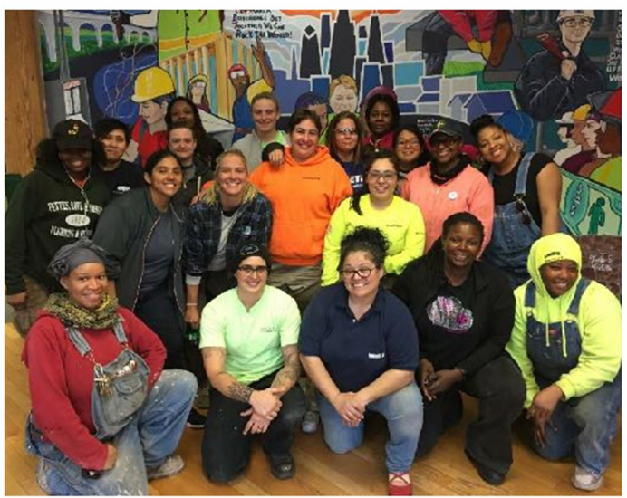
WOMEN OF UA LOCAL 130 Solidarity, Sisterhood, and Success
The more we are together as a group, the more likely a struggling person is to open up
The more visible we are, the better thought of we are by leadership, and
therefore given more opportunity/treated fair… because we are EARNING RESPECT

Slide 19
WOMEN OF UA LOCAL 130 Looking forward and challenges
Leadership check ins
We actively encourage our apprentice members to lead. This has been most successful. We try to not be dominated by a single “leader”
Control the culture as best you can:
Positive, no shit talking, private, conﬁdential, encouraging, non competitive, diﬀusing conflict
Problem people strategies! (challenging personalities, non-joiners, racist/homophobic people)

Slide 20
Being a Mentor to Tradeswomen Means Being an Ally and Advocate
Be intentional about gender inclusivity, neutrality and sensitivity
Assess your own biases, practices and cultural competency
Examine assumptions about dominant culture that might not be true for non-dominant groups.
Go out of your way to support women and other underrepresented groups
Challenge the ordinary language of the work world that excludes one gender
Be an advocate for diversity and equity with the union, contractors and apprenticeship program staff

Slide 21
LISTEN TO TRADESWOMEN! Table exercise THEIR ADVICE IF YOU WANT TO BE AN ALLY:
“Don't think that because you worked with one woman in the past that you know about working with women.”
“Talk to us. Not to people who might know us. We are all our best representatives.”
“Don't try to "school" us. Instead work with us and treat us as you would your brother.”
“Call other guys out when they're being jerks.”
“Know that often we can't speak up.

Slide 22
LISTEN TO TRADESWOMEN! THEIR ADVICE IF YOU WANT TO BE AN ALLY:
“Remember that you wouldn't blame all men for the actions of one, nor should you do that to women.”
“letting tradeswomen spread their wings, pushing them up, speaking to others about their accomplishments instead of failures,
“Remember that everyone was a beginner at one time.”
“Don't assume that you are the good guy just because you want to be. It takes listening, staying open-minded, honest dialogue and understanding”

Slide 23
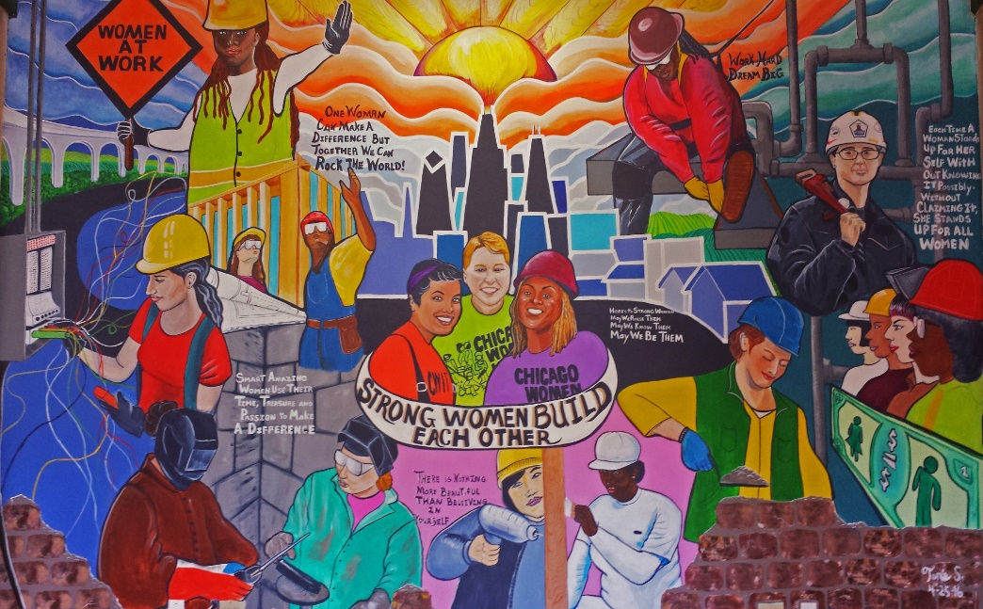
On-Line Resources
Resources, tools, curriculum available at:
www.womensequitycenter.org
2444 West 16th Street
Chicago IL 60608
www.chicagowomenintrades.org
312/942-1444

